Slide 1


How do I write course SLOs (student learning outcomes)?
Lindsey Graham Guinn August 13, 2024

Slide 2
Overview
What is a Course SLO?
Why do I need to develop Course SLOs?
How do I write Course SLOs?

Slide 3

What is a Course SLO?
A Course SLO is a clear, measurable statement that describes what students are expected to learn or achieve by the end of a course.

Slide 4
Course SLOs Characteristics
1. They state an action by the student that is observable.
2. They state an action by the student that is measurable with data.
3. They specify an action that is to be accomplished by the student within the course timeframe.
4. They align with course goals as well as program and general education outcomes.
5. They state when the outcome should be achieved.

Slide 5
S M A R T Course SLOs
Specific
Measurable
Achievable
Relevant
Time-Bound

Slide 6

Why do I need to develop Course SLOs?
Focus
Assessment
Organization
Accountability
Improvement
Transparency

Slide 7

Focus
Focus: SLOs identify what students should know and achieve at the end or the completion of a course.

Slide 8

Assessment
Assessment: SLOs help faculty evaluate the effectiveness of their course by determining what knowledge, skills, and competencies are achieved by the students completing the course.

Slide 9

Organization
Organization: SLOs guide the organizational and development of course materials so that course components align with the intended SLOs.

Slide 10

Accountability
Accountability: SLOs help demonstrate the value and effectiveness of the courses to stakeholders such as accreditors.

Slide 11

Improvement
Improvement: SLOs guide the process of continuous improvement by helping a faculty member determine the knowledge, skills, and competencies where students are excelling but where students are struggling.

Slide 12

Transparency
Transparency: SLOs clearly determine what students are expect to know and achieve at the completion of a course.

Slide 13

Writing Course SLOs
What do I want students to learn as a result of completing this course?

Slide 14
Writing Effective Course SLOs
Start with Action Verbs
1
Structure the Outcome
2
Ensure Measurability
3

Slide 15

Action Verbs
We want to use active verbs that specific observable and measurable outcomes.
Analyze
Construct
Evaluate
Develop
Compare
Create
Demonstrate

Slide 16

Action Verbs
Different verbs identify different levels of thinking skills.
Some verbs indicate basic cognitive skills while others indicate complex, higher-order or critical thinking skills.
What is best for your course?

Slide 17
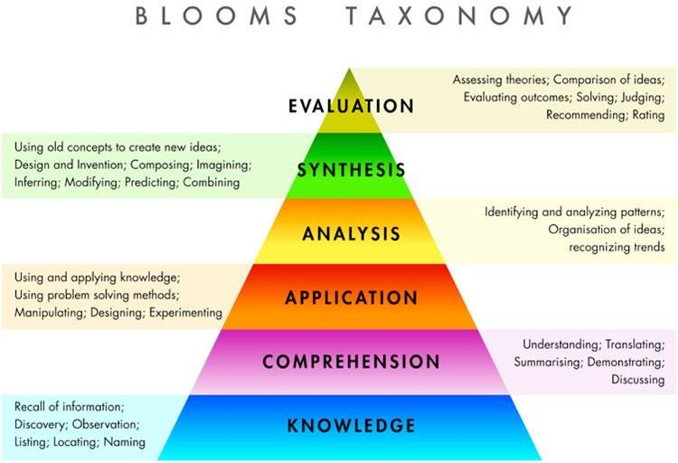
Bloom’s Taxonomy
Higher-Order Critical Thinking
    Lower-Order Recall

Slide 18

Bloom’s Taxonomy
Evaluation: To judge the quality of something based on its adequacy, value, logic, or use.
Synthesis: To create something, to integrate ideas into a solution to propose an action plan to formulate a new classification scheme.
Analysis: To identify the organizational structure of something to identify parts, relationships, and organizing principles.
Application: To apply knowledge to new situations to solve problems.
Comprehension: To understand, interpret, compare and contrast, explain.
Knowledge: to Know specific facts, terms, concepts, principles, or theories.

Slide 19
Course Considerations
Is this course required or an elective?
Is this course required for some and an elective for others?
Does this course have a prerequisite or is it a prerequisite?
Is this an introductory course or does it build on others?
What is the value of taking this course?
What do I want a student to know within 1 year or 5 years as a result of completing this course?

Slide 20

Tips
Focus on limiting the Course SLOs.
Focus on aligning the course SLOs to Program and General Education Assessment Plans
Focus on knowledge and skills that are central to the course topic and the discipline.
Focus on overarching or general knowledge and/or skills, rather than on small, trivial details.
Focus on the learning that results from the course rather than describing the lessons, activities, or assignments in the course.

Slide 21
Assessing Course SLOs
Determine how you will measure whether students have achieved the SLOs.
Test Questions
Essay Questions
Oral Presentations
Essays

Slide 22
Example Course SLOs
Example 1
Weak: The student will be able to understand human development theory.
Better: The student will be able to identify and describe two major theories of human development.

Slide 23
Example Course SLOs
Example 2
Week: The student will be able to appreciate music from other cultures.
Better: The students will be able to identify the charactersitcis of music from other cultures.

Slide 24

Activity

Slide 25

Questions

Slide 26
Review Course SLOs
lindseygrahamguinn@gmail.com

